Slide 1

CosmosDB in the Real World

Slide 2
CosmosDB
TechBash, 2019

Slide 3

Who is this guy?
Notes:
MVP is in C#, not Azure.
I don’t know what I’m talking about.

Slide 4
Scope

Slide 5
Scope
Not a sales pitch.
How to think about modeling data.
Techniques to get started today without painting into a corner.
Notes:
Kind of a grab-bag of topics I consider “important” when getting started.

Slide 6
Out of Scope
Indexes (!)
By default, indexes are automatically created. Removing indexes are a common optimization.
Stored procedures
Stored procedures only run within a partition, but get ACID guarantees.
User-defined functions
User-defined functions extend the query language.
Notes:
(but interesting and possibly useful)

Slide 7
CosmosDB: The Right Way™

Slide 8

Databases
Relational Databases: ACID
NoSQL Databases: Scalability
Key/Value
Document
Graph
Notes:
Atomicity, Consistency, Isolation, Durability
NoSQL “rah rah” – not here.

Slide 9






Azure Cosmos DB
A globally distributed, massively scalable, multi-model database service
Cosmos DB’s API for
MongoDB
Table API
Column-family
Document
Key-value
Graph
Elastic scale out
of storage & throughput
Guaranteed low latency at the 99th percentile
Five well-defined consistency models
Turnkey global distribution
Comprehensive SLAs
Notes:
CosmosDB tries to be everything. Don’t do that.

Slide 10
Which API?
The “natural” API for CosmosDB is the NoSQL API (formerly known as the “SQL API”)
Not MongoDB, PostgreSQL, Cassandra, Gremlin, or Table (Azure Storage Tables).
CosmosDB NoSQL is a document database.
Notes:
Don’t use any other API; some techniques in this talk only work with the NoSQL API.
Cassandra: column-oriented
Gremlin: graph

Slide 11
Terminology
Terminology:
Database
Container (a.k.a. Collection)
Schemaless
Item (a.k.a. Document)
Account
Database
Database
Database
Database
Database
Container
Database
Database
Item

Slide 12
SQL API Structure
Document-style NoSQL, but with keys.
Key has two parts: Partition and Id (a.k.a., Document Id).
(PartitionKey, Id) uniquely identifies an item.
We get to keep ACID within a Partition Key!
Partition Key
Id
Document
Notes:
Two-part keys work exactly like Azure Tables (Partition Key and Row Key).
In AWS, Id is the “Sort Key”.

Slide 13
Terminology
Terminology:
Database
Container (a.k.a. Collection)
Partition Key
Item (a.k.a. Document)
Id Key
(Partition Key, Id Key) must be unique
Account
Database
Database
Database
Database
Database
Container
Database
Database
Item

Slide 14
Side Note: Consistency

Slide 15
CAP Theorem
Choose two: Consistency, Availability, Partition Tolerance
In the real world, we must have Partition Tolerance, so the choice is between Consistency or Availability when a partition is lost.

Slide 16
PACELC Theorem
When Partitioned, choose between Availability and Consistency; Else, choose between Latency and Consistency.
Strong consistency + High Latency or Eventual Consistency + Low Latency
More of a continuum rather than a binary choice.

Slide 17
Consistency in CosmosDB
Provides a full spectrum of possibilities. You can even choose consistency per-request.
Strong
Bounded-stateless
Session
Consistent prefix
Eventual
Notes:
Default with Session consistency.
If you need stronger, go Bounded-Staleness.
If you don’t need as strong, go Consistent Prefix.

Slide 18
Designing the Database
Notes:
NoSQL is “schemaless”. But that doesn’t mean you don’t design your database – quite the opposite! You usually need to spend more time designing how your data is stored.

Slide 19
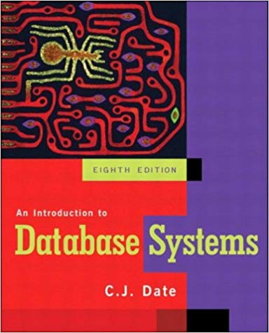
Relational Database Design
Start with nouns, and repeatedly normalize until you achieve a desired normalization form (usually 3NF).
Well-understood process; queries are a form of calculus.
Allows arbitrary queries.
Notes:
Might need to speed up by adding indexes, etc, but very efficient for any query.
Data has a "correct form" with well-understood tools to achieve that form.

Slide 20
NoSQL Database Design
Structure data according to how it's used (reads + writes).
Optimize response time, not storage.
Feel free to duplicate data!

Slide 21
Designing a Database
Relational World:
Data has a “natural shape” that permits arbitrary queries.
Design around Data
NoSQL World:
Queries/Writes determine how the data is shaped.
Design around Use Cases

Slide 22
Cost of CosmosDB
Notes:
Unlike an RDBMS, cost drives many of your design decisions.

Slide 23
Types of Charges
Storage
Units: GB-month
$0.25/GB-month
Consumption
Access
Units: “Request Units”
Measured per-request
Provisioned
E.g., “400 Rus per second”

Slide 24
What is this “RU”?
Abstract combination of CPU, memory, and I/O.
Read 1KB document: ~1RU.
Reads are primarily I/O.
Write 1KB document: ~5RU.

Slide 25
Measuring RUs
Portal
RequestChange property in SDK
x-ms-request-charge response header
Notes:
Check rate limiting in the portal.
SDK will auto-retry when out of RUs, and you want to be aware this is happening.

Slide 26
Item (Document) Design
Notes:
What goes into a single item? How should they be split up?

Slide 27
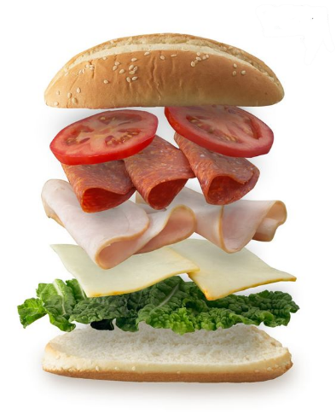



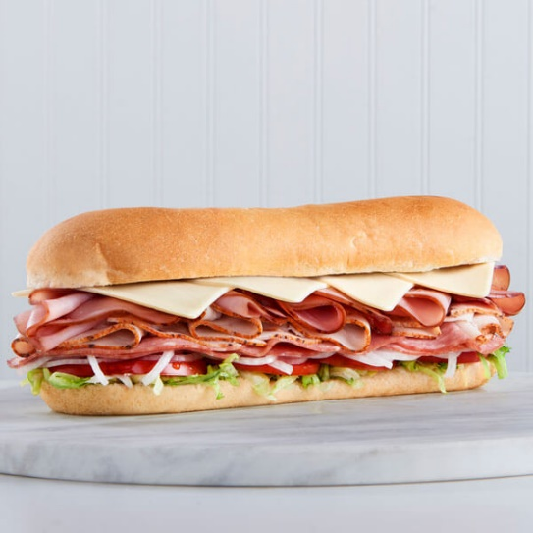
Two Extremes
ORM
Normalize everything
SQL
NoSQL
Embed as 1 piece

Slide 28
Embed vs Reference
Embed when:
Queried together
Strong child relationship
1:1 relationship
Change at the same time
Bounded documents (1:1 or 1:few, not 1:N)
Optimizing reads (fewer queries)
Notes:
“Strong child relationship” – like parts of an order.

Slide 29
Embed vs Reference
Reference when:
Unbounded 1:N relationships
M:N relationships (use join table or embedded collections)
Change at different times
Key entity used by many others
Optimizing writes (smaller documents)
Notes:
“Key entity used by many others” – don’t want to embed all over the place.

Slide 30

Embed vs Reference
Notes:
Very informal “rules”. Completely different than normalization forms. Opinions abound.
“What if I do it wrong?” Stay tuned…

Slide 31
Denormalization and Normalization
Deliberate Denormalization:
Duplicate data across documents to avoid “lookup queries”
E.g., every query retrieving a user wants a username, not user id.
Normalized is still useful when optimizing write speed.

Slide 32
Schemaless
Reminder: you can store multiple document types in a single collection!
They do have to share a partition key.
Commonly distinguished by a string “type” field.
Which can be part of a composite Id key.
Notes:
All of this is a judgement call!

Slide 33
Partitions
Notes:
Most of your CosmosDB decisions are going to come down to “how do I partition my data?”

Slide 34


Terminology (Review)
Terminology:
Database
Container (a.k.a. Collection)
Partition Key
Item (a.k.a. Document)
Id Key
(Partition Key, Id Key) must be unique
Account
Database
Database
Database
Database
Database
Container
Database
Database
Item

Slide 35
Logical vs Physical Partitions
Logical partitions are defined by our Partition Key (hashed).
Physical partitions are managed by CosmosDB.
Each physical partition covers a range of logical partitions.
Split and/or moved as necessary.
Most of the time, we only have to think about logical partitions.
Notes:
Logical partitions: determine ACID scoping, etc.
Physical partitions: which CosmosDB nodes those logical partitions live on.

Slide 36
Physical Partitions
The one time we really need to think about them:
RUs are divided among physical partitions.
This means, e.g.:
1000 RUs with 5 physical partitions means each one is limited to 200 RUs.
A partition with a lot of data can be throttled at a fraction of your provisioned RUs.
Notes:
Corollary: avoid hot logical partitions.

Slide 37
Choosing a Partition Key
One Partition Key defined per Container (for all Item types)
Partition Keys are hashed, but equal keys have equal hashes.
20GB limit per Partition Key value.
Hierarchical partition keys support multi-valued keys in a tree rather than hash.

Slide 38
Choosing a Partition Key
Goals:
Distribute data
High cardinality
Distribute requests
Keep multi-entity transactions within a single partition
Notes:
Distribute data (allows physical partitions to be more efficient)
High cardinality (lots of smaller partitions are better than a few larger partitions)
Distribute requests (prevent hot partitions)
Still guidelines: it’s usually impossible to accomplish all of these.

Slide 39
Measure and Improve
First:
Get a ballpark of scale: both size and throughput.
Read-heavy or Write-heavy?
Next step:
Reads: Understand the top 3-5 read queries (shape).
Writes: Understand transactional requirements for writes.

Slide 40
Rule of Thumb Analyzing Queries
Best: point lookup.
Query for known partition key and (item) id.
Next-best: single partition.
Query filtered by partition key.
Next-best: partial hierarchical partition key.
Worst: fan-out.

Slide 41
Partition Keys: Not Just a Single Value
It’s often useful to define a PK as a composite key.
Even better: hierarchical primary keys.
It’s not as useful to define a PK as a fully synthetic key.
(Prevents efficient queries)

Slide 42

Partitions
Notes:
Read a ton of information about “how to partition”. Still don’t know “the answer” because there isn’t one. There is no “third normal form”.
Solution: start with your best guess. Measure and iterate. Stay tuned for techniques.

Slide 43
Change Feed
Notes:
The killer feature of CosmosDB; NoSQL API or Graph API (Gremlin) only!

Slide 44



Cosmos DB Change Feed
Azure Function
CosmosDB
Change Feed
Persistent log of items within an Azure Cosmos DB collection in the order in which they were modified
Notes:
Change Feed Processor – usually Azure Functions

Slide 45
Use Cases
Secondary indexes
Continuous backup/archive to colder storage
Intermediate step in changing database structure

Slide 46
Use Case: Secondary Index
I have a User document that is partitioned on Username.
I want to also (quickly) query by Email (without Username).
Solution:
Create a second Container using a different Partition Key.
Copy User documents from old Container to new.
Notes:
(keep the old User documents)
Change Feed Processor is persistent – permanently part of our database.

Slide 47
Use Case: Secondary Index
Azure Function
User collection; partition = /username
UserByEmail collection; partition = /email
Change Feed
Query by username
Query by email
Notes:
Note: secondary indexes are eventually consistent!

Slide 48
Use Case: Changing Partition Key
My first choice of PK was stupid. But I have learned! I need to change the PK on my collection.
Solution:
Create new collection with better PK.
Migrate existing data to new collection.
Change readers to access new collection.
Change writers to write to new collection.
Remove migration change feed processor.
Notes:
Zero-downtime migration!
This change feed processor is temporary; once the migration is done, delete the change feed processor and old collection.

Slide 49
Coming soon!
In public preview as of Build 2025:
Global Secondary Indexes
https://learn.microsoft.com/en-us/azure/cosmos-db/nosql/global-secondary-indexes
Asynchronous replication, read-only.
Notes:
Essentially Microsoft maintaining that change feed and Azure Function for you.

Slide 50
Additional Use Cases
Reliable queue of work
Materialized views
Summaries
Pre-aggregated data

Slide 51
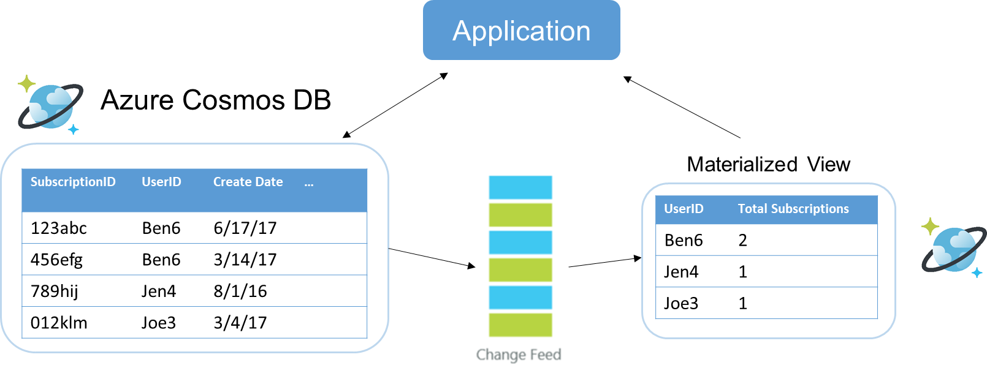
Use Case: Materialized View
Notes:
(don’t remember where I copied this image from)

Slide 52
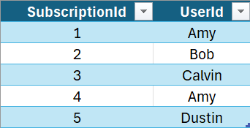
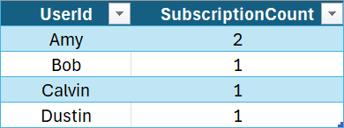
Use Case: Materialized View
Application
Azure Function
Change Feed

Slide 53
Change Feed Processors

Slide 54
What to Use?
(When released, if possible) Use Global Secondary Indexes.
Use Azure Functions. Period.
If you can’t, then use the Change Feed Processor Library.
Do not use the API directly. Unless you like padded cells.

Slide 55
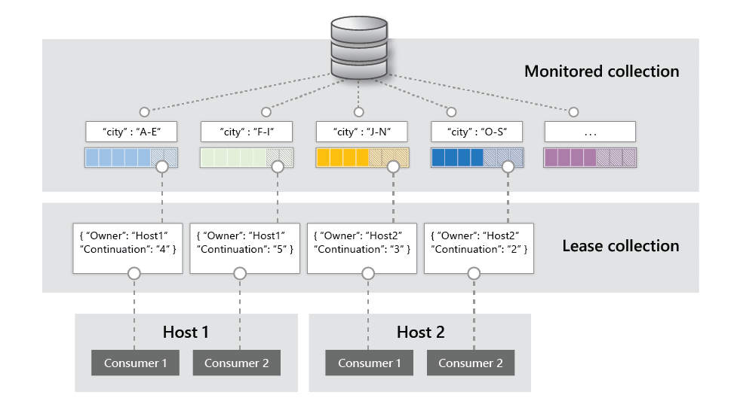

Under the Hood
Requires a “leases” collection
~400RU
Partition key of /id
Reads from change feed do cost normal RU
(generally 1RU per document)
Source:
Notes:
Spin up instances of the processor as needed
Each host has consumers = observer to implement
Each host assigns itself leases on partitions to monitor
On each change, logic in consumers gets triggered
1 lease collection stored in Cosmos DB

Slide 56
Azure Functions Change Feed Processor
[Function("MyChangeFeedConsumer")]
public static void Run(
[CosmosDBTrigger("MyDatabase", "MyContainer",
Connection = "MyConnectionStringSetting",
CreateLeaseContainerIfNotExists = true,
StartFromBeginning = true)]
IReadOnlyList<MyDocument> documents)
{
// Do something with documents
}

Slide 57
Azure Functions Change Feed Processor
[Function("MyCollectionCopier")]
[ExponentialBackoffRetry(5, "00:00:02", "00:10:00")]
[CosmosDBOutput("MyDestDatabase", "MyDestContainer",
Connection = "MyDestConnectionStringSetting",
CreateIfNotExists = true)]
public static IEnumerable<MyDocument> Run(
[CosmosDBTrigger("MySourceDatabase", " MySourceContainer",
Connection = "MySourceConnectionStringSetting",
CreateLeaseCollectionIfNotExists = true,
StartFromBeginning = true)]
IReadOnlyList<MyDocument> changes)
{
return changes;
}
Notes:
E.g., for creating a secondary index, or doing a migration from one partition key to another.

Slide 58
Change Feed Limitations
Notes:
The most important section of this talk.

Slide 59
Ordering
Only guaranteed within a partition.
Single partition key value.
Changes for other partition key values can be seen “out of order”.
Not usually a problem.
Notes:
Remember that it’s normal to have multiple change feed processors running simultaneously.

Slide 60
Completeness
NOT an “event sourcing” system:
No total ordering; only partial ordering.
Updates can be merged.
Each change feed update comes with the complete new document.
Event sourcing is coming, though:
- “All versions and deletes” mode is in public preview.
Notes:
A lot of the MS docs refer to the change feed as a kind of “event sourcing”.
I disagree with their use of this term.

Slide 61

Deletion Notifications
Inserts and Updates are in the Change Feed. Deletes are not.
Workaround:
Add isDeleted as a soft deletion.
Setting this to true causes an Update in the Change Feed.
Then either:
Set a TTL to remove the document automatically.
Have the Change Feed Processor delete the document.
Again, “all versions and deletes” mode is in public preview.
Notes:
Here Be Dragons:
If you set TTL and your change feed processors don’t get to it in time, they never see the update!
If your change feed processor deletes it, it has to know all the other change feed processors have already seen it!

Slide 62
Change Feed Considerations

Slide 63
When Things Go Wrong
If your Change Feed Processor has a problem:
Leases container knows those documents were not processed.
Will release those documents to another processor for that partition.
“At Least Once” -> Idempotent processors

Slide 64
Migration Timing
Can shut down during busy times. Leases collection “keeps your place”.
Can also temporarily increase RUs.

Slide 65
Multiple Change Feed Processors
Can have multiple listeners:
If using same lease collection and lease prefix string, then they share the same stream of changes.
E.g., scale out a single Azure Functions Processor.
If using different lease collection or lease prefix string, then they get their own stream of changes.
E.g., different Azure Function Processors to create multiple secondary indexes.

Slide 66
Deployment
Permanent change feed listeners are logically part of your database!
Azure Function
User collection; partition = /username
UserByEmail collection; partition = /email
Change Feed
Notes:
Not sure how to best address deployment with this in mind.
Perhaps it’s time to stop thinking about “database deployments” and move to a “live migration” mindset?
(Always On, Live Migrations)

Slide 67


Useful Links
Partitioning:
https://docs.microsoft.com/en-us/azure/cosmos-db/partitioning-overview
https://docs.microsoft.com/en-us/azure/cosmos-db/synthetic-partition-keys
Change Feed:
https://docs.microsoft.com/en-us/azure/cosmos-db/change-feed https://docs.microsoft.com/en-us/azure/cosmos-db/how-to-use-change-feed-estimator
Best Docs Ever:
https://docs.microsoft.com/en-us/azure/cosmos-db/how-to-model-partition-example
AI:
https://github.com/microsoft/vscode-cosmosdb/blob/main/resources/llm-assets/azurecosmosdb.instructions.md

